Slide 1
Car dealerships
Work done By:
Amin Alsultan

Slide 2
Car Dealership
Abstract | 3
Introduction | 3
Literature Review | 4
Design Methodology | 5
Requirements | 5
Use Cases | 6
Physical System | 9
User Interface | 9
Database | 12
Implementation | 15
Tools | 15
Programming Language | 16
Coding | 16
Testing | 18
Completion Process | 18
Conclusion & Future WORK | 19

Slide 3
Introduction
The QUALITY Cars Seller is a project about vehicles retailing and shipping. The system is designed to accommodate all types of customers to understand the market and take the best decision for their vehicles. Our system reduces the cost of visiting markets and search for their desired thing and compromising on your one or more desires while buying because of less choice and option at the time of purchasing. Our system provides the old and new variety of vehicles according to the customer’s interest that they will love to buy so it makes a lot easy for them to choose best for them in one place.

Slide 4
Use Cases
There are only two use case scenarios for customer and admin will not have any interface they will add or remove data from database.
1- View item
2- Search item

Slide 5
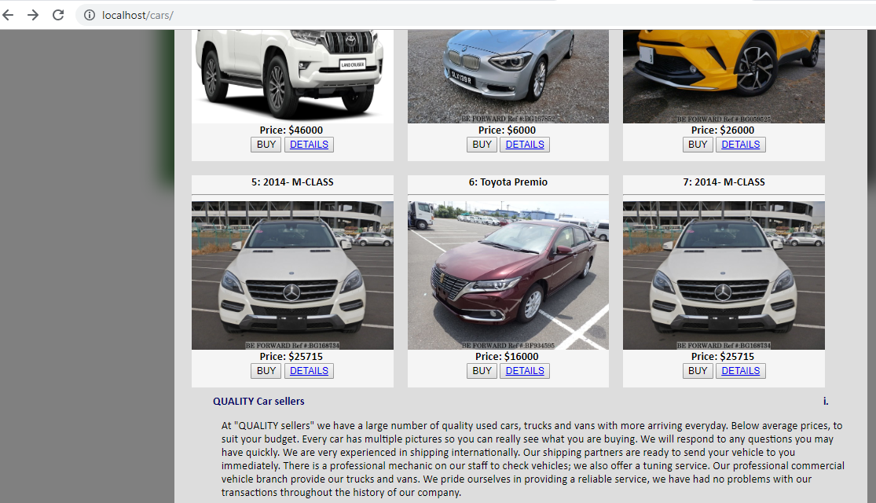
This page is showing vehical name pictue and price for the sake of conviente to our customers.

Slide 6
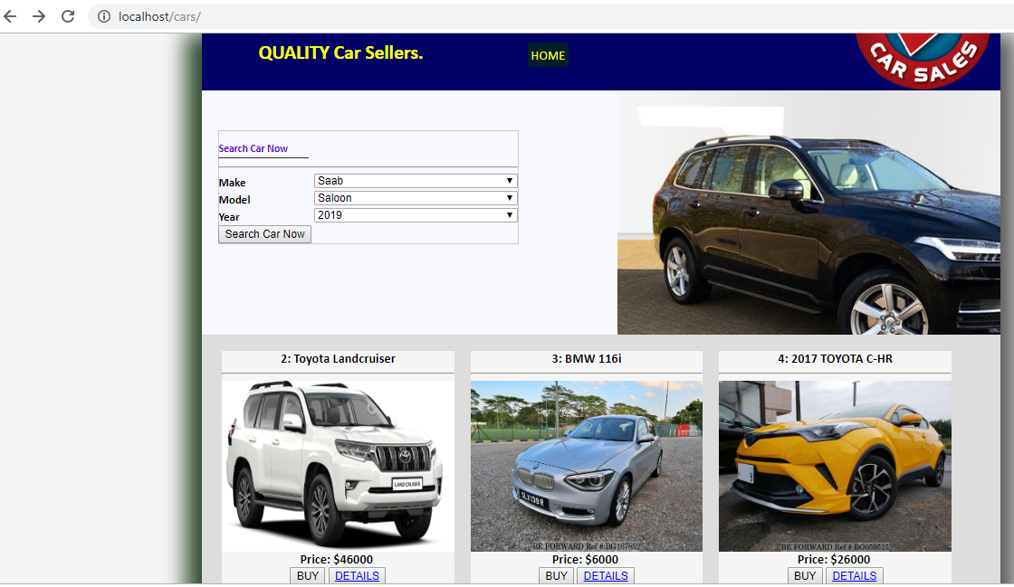
Searching
The below page represents the searching function where customer inputs the required fields, and click on the search button.

Slide 7
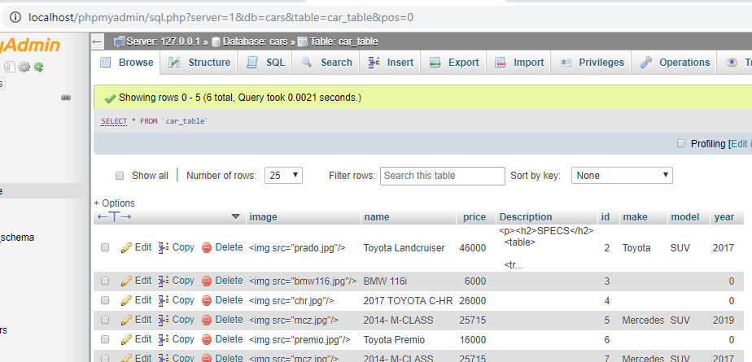
Database
Our system uses SQL database for storing vehicles data, and we have created table with specific fields to store our data in the correct format. Here is the illustration of our database table.

Slide 8
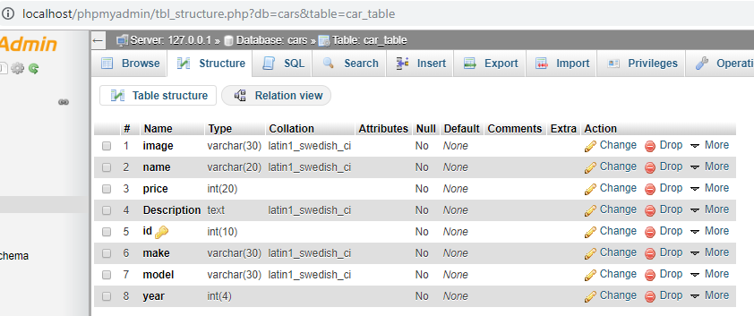
Database

Slide 9
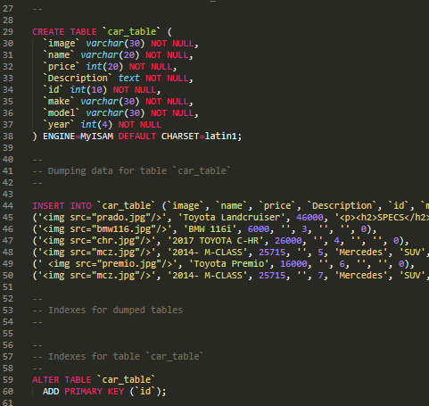
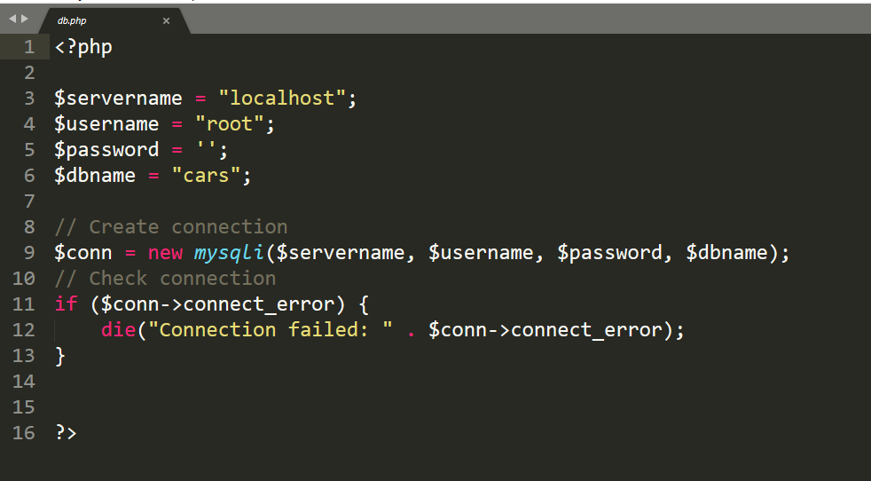
Code

Slide 10
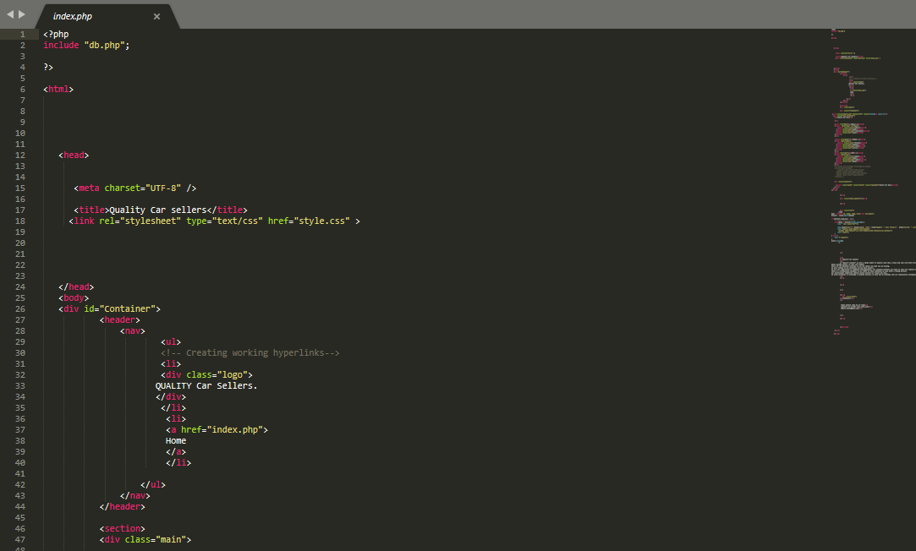
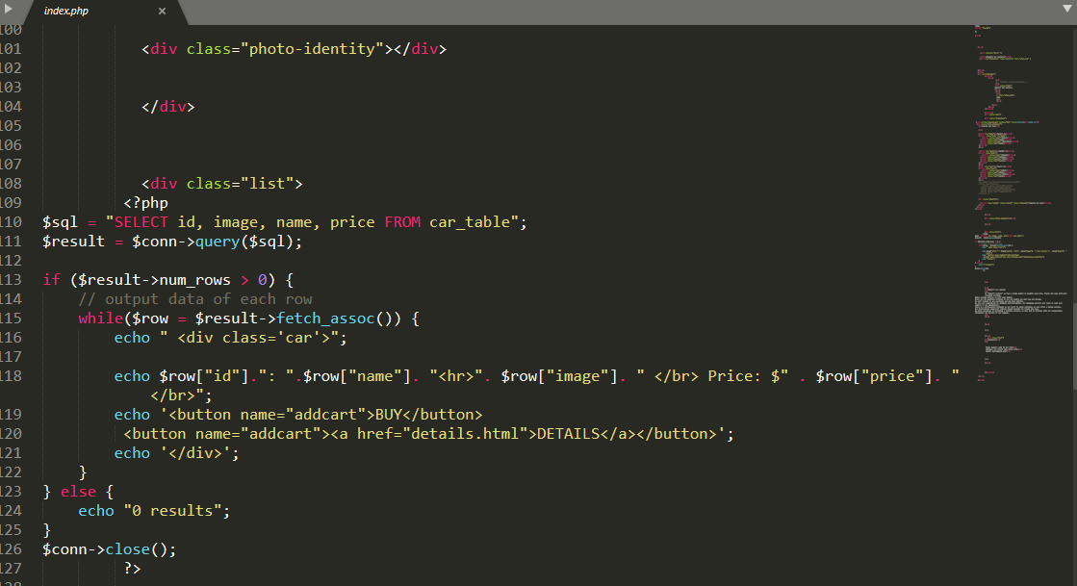
Code

Slide 11
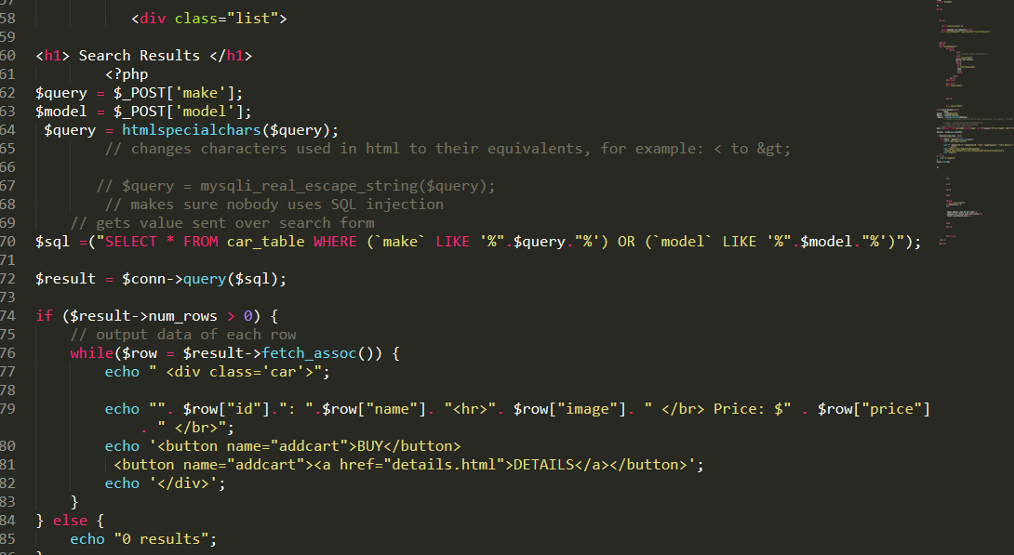
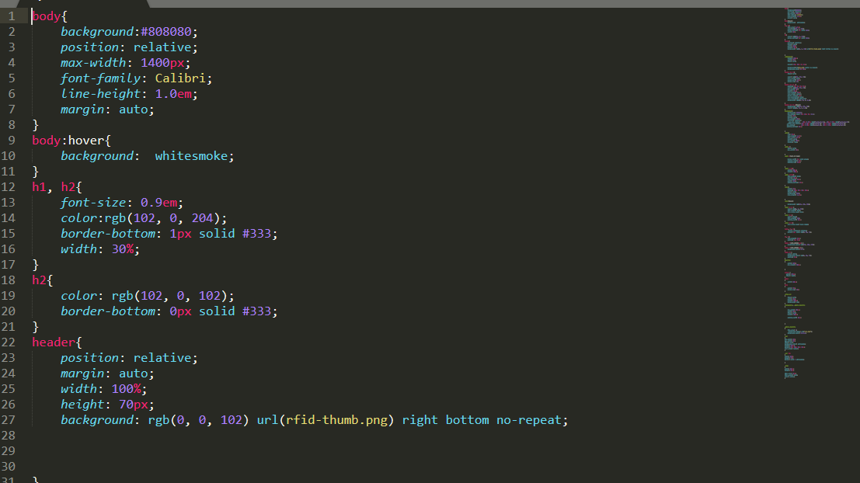
Code

Slide 12
Conclusion and Future Work
This project is all about facilitating our customers to buy their best item by making the best decisions through our system. Our system completely fulfills the customer’s needs as it has a well-organized interface that everyone will easily use and find a search function for their choice. This system is completely according to the customer’s interest and provides benefits of decision making at their home. So, we meet our goal and expectations quiet efficiently and want to add more and more content in the database for our customers. And we want to have some extensions also to provide more benefits to our customers like online booking for vehicles.
This system needs more and more data to view customers and for the searching facility if we have more content related to that search it will be more effective for our customers. This system can be extended for online booking of their desired item to avoid conflicts of interest in between two customers. We have learned a lot from this project and improve our knowledge related to implementations for such type of projects. We use typical software development lifecycle by gathering requirements then design a system. During implementation, we face some problems in requirements. So, it is most important to have a clear cut and specific requirement details to implement a system perfectly. We will next time take extra care for requirements gathering and analysis in order to make the project successful and to fulfill customers and clients desires.

